Slide 1
Homework 1 – Part 3
Visual Models

Slide 2
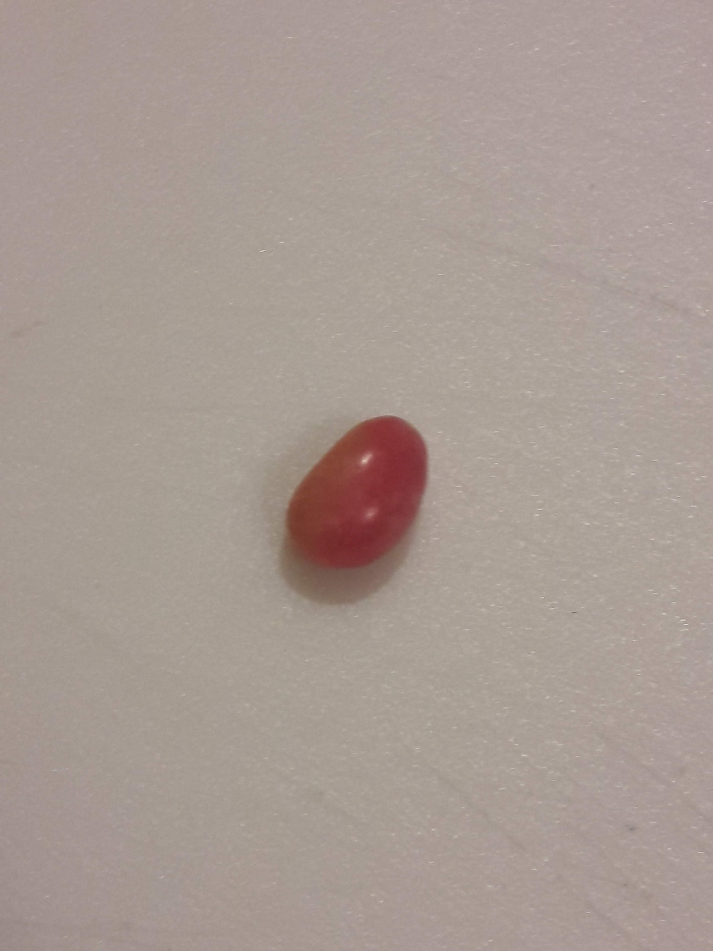
Dataset::Gummi
> Gummi[1]
2.5 1 Yes Red Orange
# an element

Slide 3
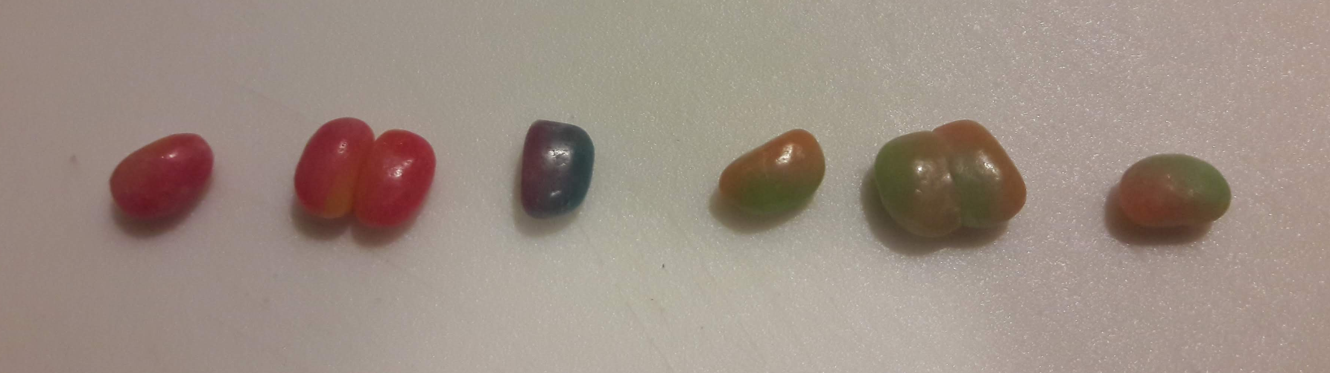
Dataset::Gummi
> Gummi$length
2.5 4.7 2.9 2.3 5.0 3.0
# a vector

Slide 4
Dataset::Gummi
> Gummi$length
2.5 4.7 2.9 2.3 5.0 3.0
# a vector

Slide 5
Dataset::Gummi
> Gummi
length.mm numegg >50.col prim.col second.col
[1] 2.5 1 Yes Red Orange
[2] 4.7 2 Yes Yellow Red
[3] 2.9 1 No Blue Red
[4] 2.3 1 No Green Orange
[5] 5.0 2 No Green Orange
[6] 3.0 1 Yes Orange Green
# data frame

Slide 6
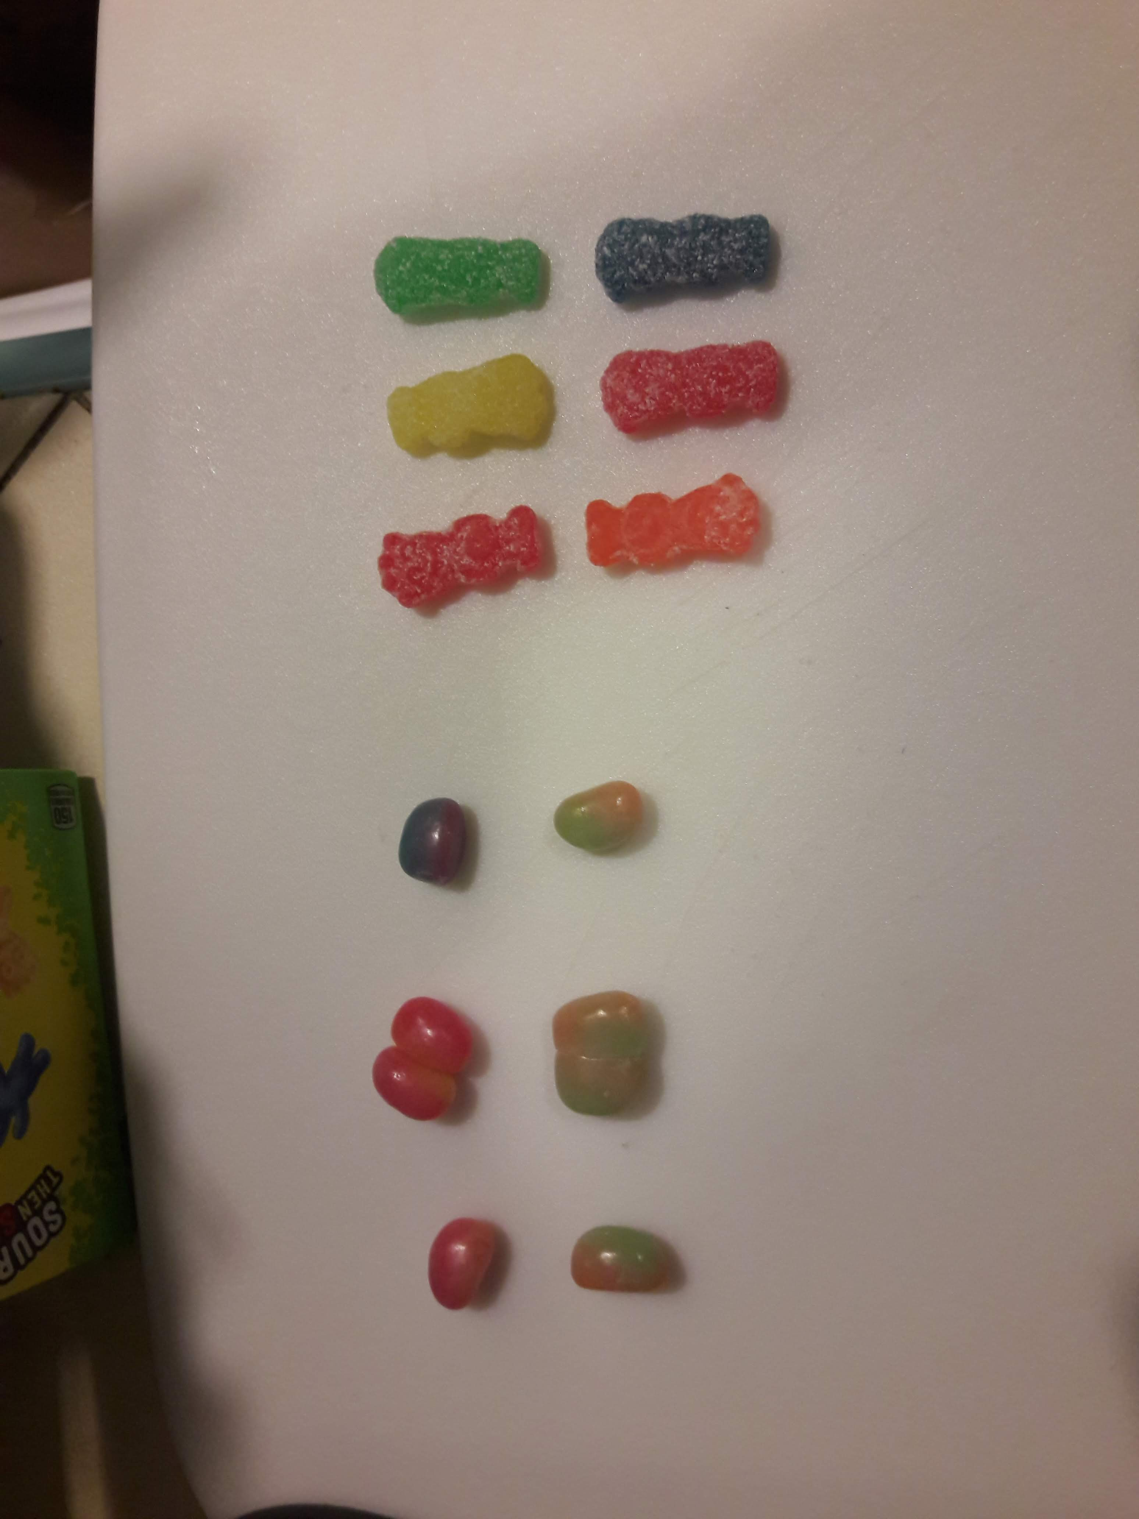
Dataset::Gummi
> as.matrix(Gummi$numegg, nrow=2, ncol=3)
[,1][,2][,3]
[1,] 1 2 1
[2,] 1 2 1
# a data frame

Slide 7
Dataset::Gummi
> as.list(c(Gummi, SourPatch))
[[1]]
[,1][,2][,3]
[1,] 1 2 1
[2,] 1 2 1
[[2]]
[,1] [,2] [,3]
[1,] up dwn up
[2,] dwn up up
# a list

